Slide 1
PROBLEM TASK- 4
Team- Respect++
Pranav Agrawal
Shreyas Badami

Slide 2
Motivation
Given the prompt, we first did research on healthcare services of india. Our primary sources for this analysis were the annual report released by the ministry of health and family welfare(https://main.mohfw.gov.in/documents/publication) ,rural healthcare report 2021-2022(https://main.mohfw.gov.in/documents/reports) and a variety of media publications
What we found was shocking. We discovered that not only primary health centers in rural India suffer from a lack of primary health workers, but there is also a cataclysmic shortfall for doctors, especially specialists, the short fall for whom reach nearly 70 percent.
According to investigative reporting, it was reported that the major reason for the lack of proper manpower available in rural healthcare sector is the low income and the prospect of halting education to pursue such work

Slide 3
We realized our initial reaction of building an app which connects people in rural areas to urban doctors was flawed, or at least only part of the solution.
What we need to do is to provide a way to incentivize the doctors to spare some time from the lucrative practice in urban to do charitable work in rural areas
Moreover, we also discovered, that the medical records, past illnesses and family genetical information was severely lacking for people in rural areas, thus there was also a need to provide them ways to store such information seamlessly

Slide 4
Planned Features
Matching doctors and patients based on symptoms or required specialization.
Patients are informed of the Insurances which cover a particular doctor’s service.
Appointment booking and video call features.
Each patient is given space on a private cloud where he can upload medical documents and the prescriptions/diagnosis given by doctors is automatically recorded.
Patients are matched with doctors who speak their language.

Slide 5
Users can find consolidated information about various Insurance policies.

Slide 6
IMPLEMENTATION
What our application is designed to do is keep a database of all the doctors who register in our app. Thus, we use this database to service requests by people in all areas(urban and rural) and from all economic backgrounds.
Each doctor can charge for his consultancy what he deems appropriate. Thus, our app acts as a normal match maker service between healthcare providers and consumers.
What is special about our implementation is that each doctor is earns “karma points” based on if the patient was in a rural area and if the service was provided for free of cost or below average prices

Slide 7
These points will influence the ordering of the search results.
The purpose of the points is that since even well-off people will avail the services for which they will be charged, it is highly lucrative for a private practitioner if his name comes at the top of search results.
Our application responds to the query of the user based on if they have searched by the id of the doctor, the specialization they need, or just a search based on their symptoms to match them with the appropriate specialist
Thus, the points act as a “bias” which promotes medical practitioners which serve their community

Slide 8
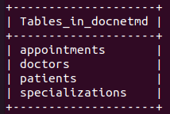
Database Schema
These are the tables present in the database

Slide 9
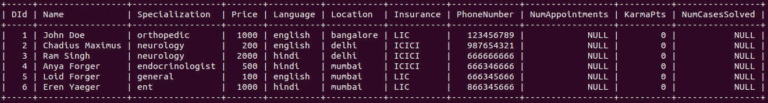
Doctors Table
Keeps a record of the Doctor’s Info

Slide 10
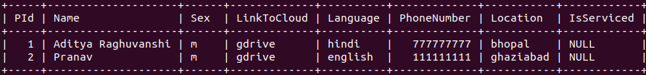
Patients Table
Keeps a record of Patients Info

Slide 11
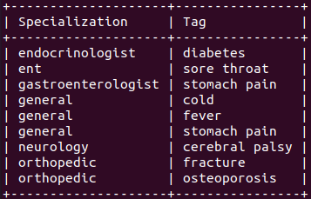
Specializations Table
A mapping of various tags/symptoms to different specializations

Slide 12
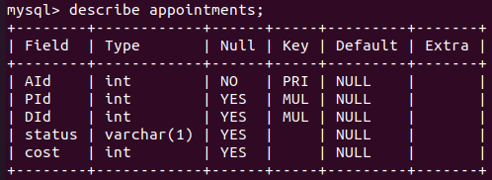
Appointments Table
A table to keep track of appointments

